Slide 1
E-Factor
Environmental Impact Factor

Slide 2
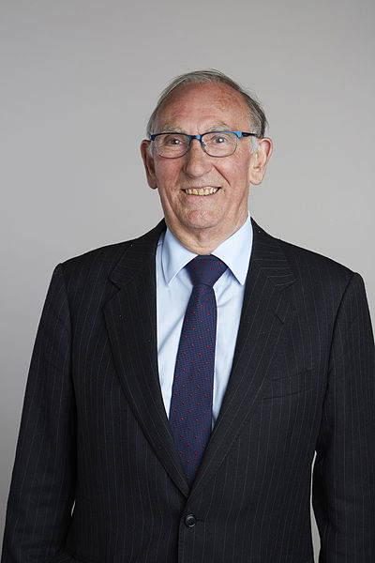
History
The Royal Society [CC BY-SA 3.0 (http://creativecommons.org/licenses/by-sa/3.0) or CC BY-SA 4.0 (http://creativecommons.org/licenses/by-sa/4.0)], via Wikimedia Commons
In the late 1980s Roger Sheldon introduced E-factor to evaluate the environmental impact of manufacturing processes.

Slide 3
A basic process…
Product
MATERIALS
PROCESS
WASTE

Slide 4
Calculations…
E-factor measures the amount of waste produced in a certain process.
            E-factor is calculated by dividing the mass of waste (kg) by the mass of product (kg)
Waste (kg)
Efactor = ------------------
Product (kg)
THE GOAL IS ZERO !

Slide 5

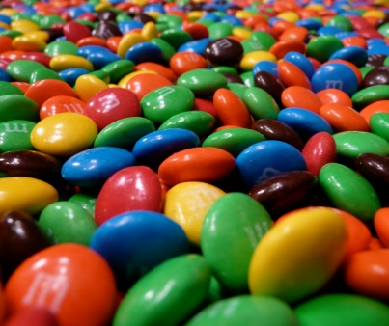
Your basic process…
Product
MATERIALS
M&Ms
PROCESS = separation of final product
http://www.hackettstownbid.com/news/2012/9/mars-chocolate-north-america-brings
WASTE
Forever M&Ms by Vern Hart is licensed under Creative Commons BY-NC-SA
http://www.hackettstownbid.com/news/2012/9/mars-chocolate-north-america-brings

Slide 6
How can you reduce your e-factor?
Product
MATERIALS
M&Ms
PROCESS = separation of final product
http://www.hackettstownbid.com/news/2012/9/mars-chocolate-north-america-brings
WASTE
Forever M&Ms by Vern Hart is licensed under Creative Commons BY-NC-SA
http://www.hackettstownbid.com/news/2012/9/mars-chocolate-north-america-brings

Slide 7
Your mission:
Refer back to the 12 Principles
Write down strategies you can use to reduce the amount of waste
Come up with as many strategies as possible!
THE GOAL IS ZERO WASTE !

Slide 8
Principle
1. Prevention. Design chemical syntheses to prevent waste, leaving no waste to treat or clean up.
2. Atom Economy. Design syntheses so that the final product contains the maximum proportion of the starting materials. There should be few, if any, wasted atoms.
3. Less Hazardous Chemical Synthesis. Design syntheses to use and generate substances with little or no toxicity to humans and the environment.
4. Designing Safer Chemicals. Design chemical products to be fully effective, yet have little or no toxicity.
5. Safer Solvents & Auxiliaries. Avoid using solvents, separation agents, or other auxiliary chemicals. If these chemicals are necessary, use innocuous chemicals.
6. Design for Energy Efficiency. Run chemical reactions at ambient temperature and pressure whenever possible.

Slide 9
Principle
7. Use of Renewable Feedstocks. Use raw materials and feedstocks that are renewable. Renewable feedstocks = farm products or the wastes of other processes; depleting feedstocks = fossil fuels (petroleum, natural gas, or coal) or are mined.
8. Reduce Derivatives. Avoid using blocking or protecting groups or any temporary modifications if possible. Derivatives use additional reagents and generate waste.
9. Catalysis. Minimize waste by using catalytic reactions. Catalysts are used in small amounts and can carry out a single reaction many times. They are preferable to stoichiometric reagents, which are used in excess and work only once.
10. Design for Degradation. Design chemical products to break down to innocuous substances after use so that they do not accumulate in the environment.
11. Real-time Analysis for Pollution Prevention. Include in-process real-time monitoring and control during syntheses to minimize or eliminate the formation of byproducts.
12. Inherently Safer Chemistry for Accident Prevention. Design chemicals and their forms (solid, liquid, or gas) to minimize the potential for chemical accidents including explosions, fires, and releases to the environment.

Slide 10
Strategies:
Reducing or eliminating derivatives or Solvents & Auxiliaries =
Using a catalyst instead of stoichiometric reagents =
http://www.hackettstownbid.com/news/2012/9/mars-chocolate-north-america-brings
http://www.hackettstownbid.com/news/2012/9/mars-chocolate-north-america-brings
http://www.hackettstownbid.com/news/2012/9/mars-chocolate-north-america-brings
Use real time analysis=
Use renewable feedstocks=
http://www.hackettstownbid.com/news/2012/9/mars-chocolate-north-america-brings

Slide 11
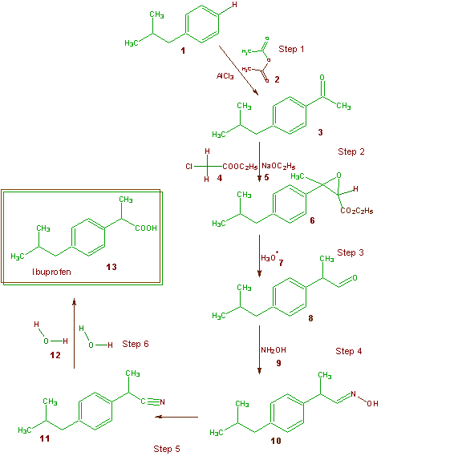
How Ibuprofen is synthesized
© Pfizer Inc. 2008
Notes:
Pfizer was able to reduce the number of steps, reduce the amount of waste, and complete the new reaction as a one pot synthesis (less solvent, etc). The use of catalysts is key to the improved e-factor.

Slide 12


© Pfizer Inc. 2008
Notes:
With the old method, that means that there would be 68.72 tonnes of waste = 69 female walruses of waste.

Slide 13
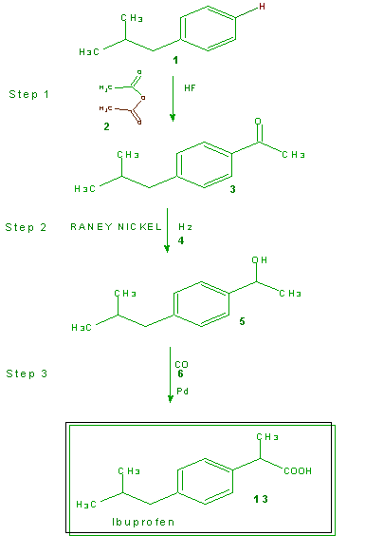
Improved Synthesis of Ibuprofen
77% reduction in waste
Graphic from Green Chemistry Department, University of Scranton
© Pfizer Inc. 2008
Notes:
Pfizer was able to reduce the number of steps, reduce the amount of waste, and complete the new reaction as a one pot synthesis (less solvent, etc). The use of catalysts is key to the improved e-factor. The acetic acid is used as a catalyst.

Slide 14
© Pfizer Inc. 2008
Notes:
Point out that the current and better method = 13.33 tonnes of waste, 13 female walruses.

Slide 15

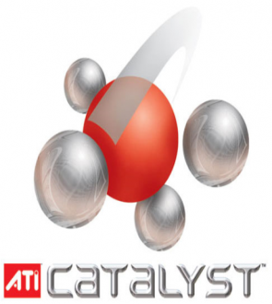
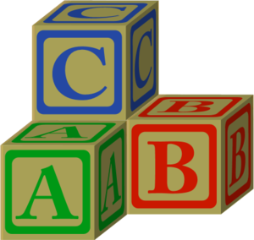

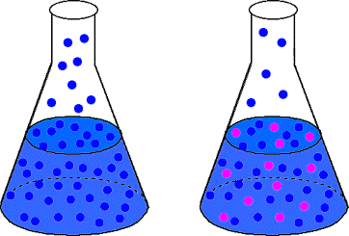
Reduce Derivatives. Avoid using blocking or protecting groups or any temporary modifications if possible. Derivatives use additional reagents and generate waste.
Real-time Analysis for Pollution Prevention. Include in-process real-time monitoring and control during syntheses to minimize or eliminate the formation of byproducts.
Catalysis. Minimize waste by using catalytic reactions. Catalysts are used in small amounts and can carry out a single reaction many times. They are preferable to stoichiometric reagents, which are used in excess and work only once.
Use of Renewable Feedstocks. Use raw materials and feedstocks that are renewable. Renewable feedstocks = farm products or the wastes of other processes; depleting feedstocks = fossil fuels (petroleum, natural gas, or coal) or are mined.
Safer Solvents & Auxiliaries. Avoid using solvents, separation agents, or other auxiliary chemicals. If these chemicals are necessary, use innocuous chemicals.
Notes:
Focus on safety for the worker. Explosions in the lab are bad.
Use less hazardous reagents and chemicals in the process to make products
Pay attention to your chemical reaction and collect data while it is happening. That way, you won’t mess it up.
Which of these 3 principles did we adhere to during our process? How could we change our process to more closely follow the 12 principles?

