Slide 1
Modeling Biologic Development
Science Buddies
www.sciencebuddies.org
Lesson Plan
2025
Notes:
www.sciencebuddies.org

Slide 2
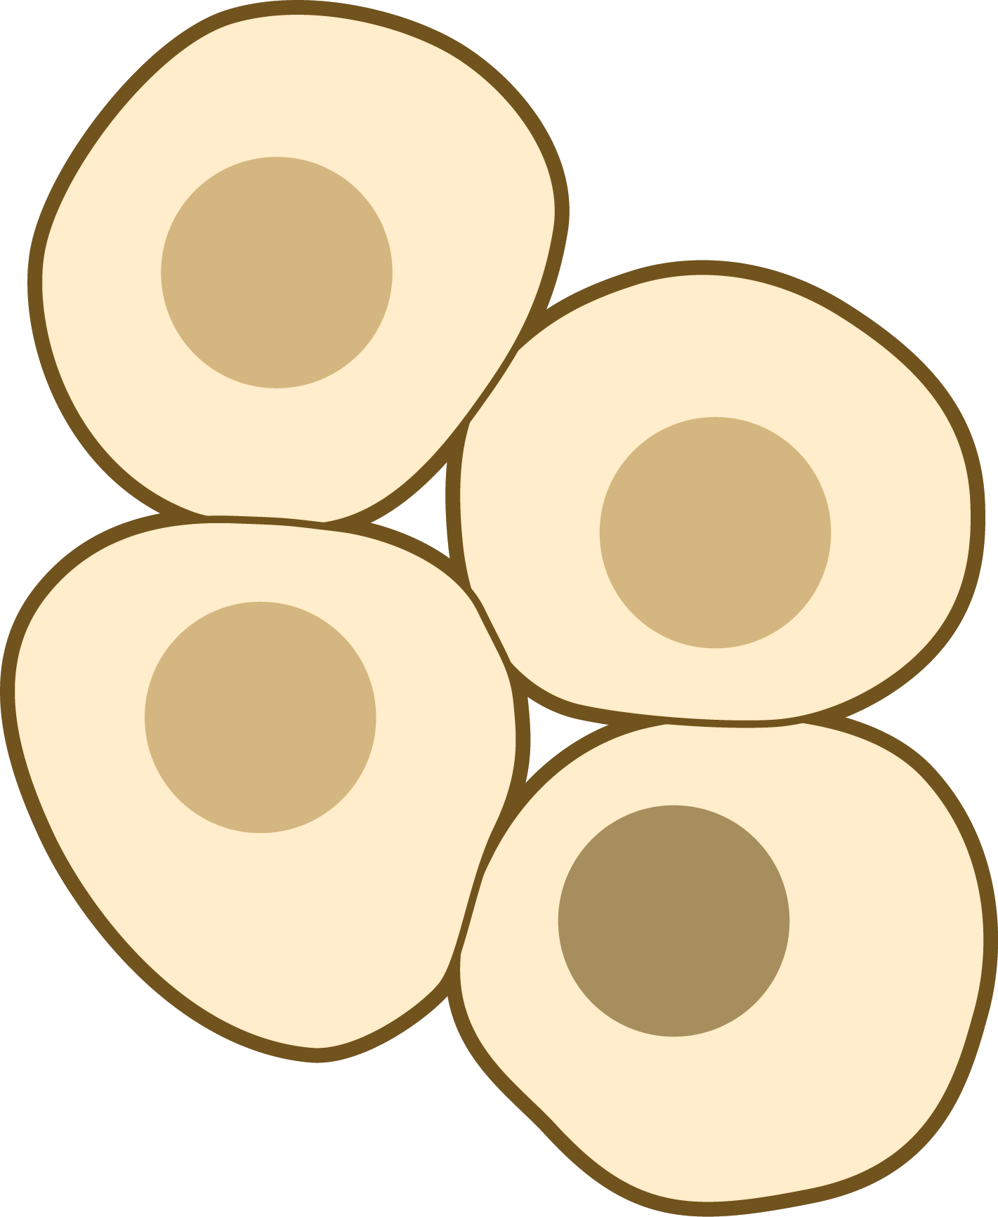



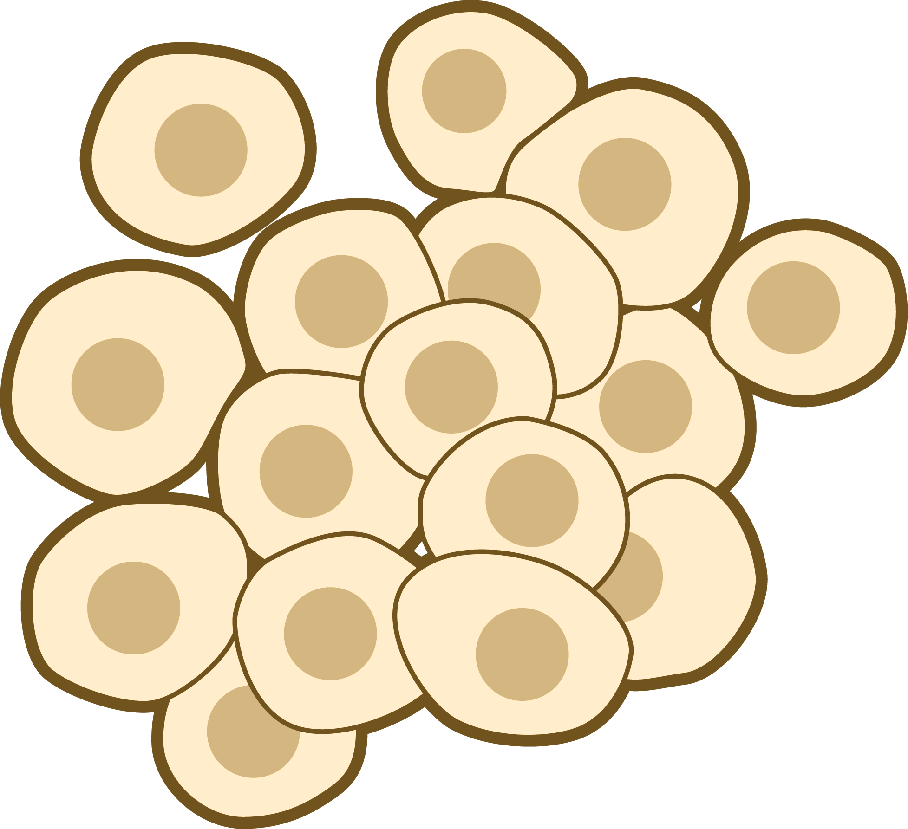
NIAID Visual & Medical Arts - NIH BioArt
Creative Commons Attribution Non-Commercial ShareAlike 3.0
Notes:
www.sciencebuddies.org
Caption: Overview of the basic steps of the drug development process modeled in this activity.
Image Credit: Laura Ohl, PhD images adapted from NIAID Visual & Medical Arts - NIH BioArt, Creative Commons Attribution Non-Commercial ShareAlike 3.0

Slide 3
1. Cell Expansion & Protein Production
2. Protein Harvested from Cells
3. Protein Purification from Cell Debris
Cell Expansion & Protein Production
Cell Expansion & Protein Production
Cell Expansion & Protein Production
Cell Replication
Harvested Protein
Filter to remove cell debris
Few cells with proteins
Many replicated cells with proteins
Lysed or broken cell and the debris
Purified protein
NIAID Visual & Medical Arts - NIH BioArt
Creative Commons Attribution Non-Commercial ShareAlike 3.0
Notes:
www.sciencebuddies.org
Figure 1. Three major steps of the drug development process for biologic development. (1) Cells must expand and produce proteins within the cells. (2) The cells are then lysed to isolate the proteins. (3) Cell debris is filtered from the protein and purified through filtration.
Image Credit: Laura Ohl, PhD images adapted from NIAID Visual & Medical Arts - NIH BioArt, Creative Commons Attribution Non-Commercial ShareAlike 3.0

Slide 4
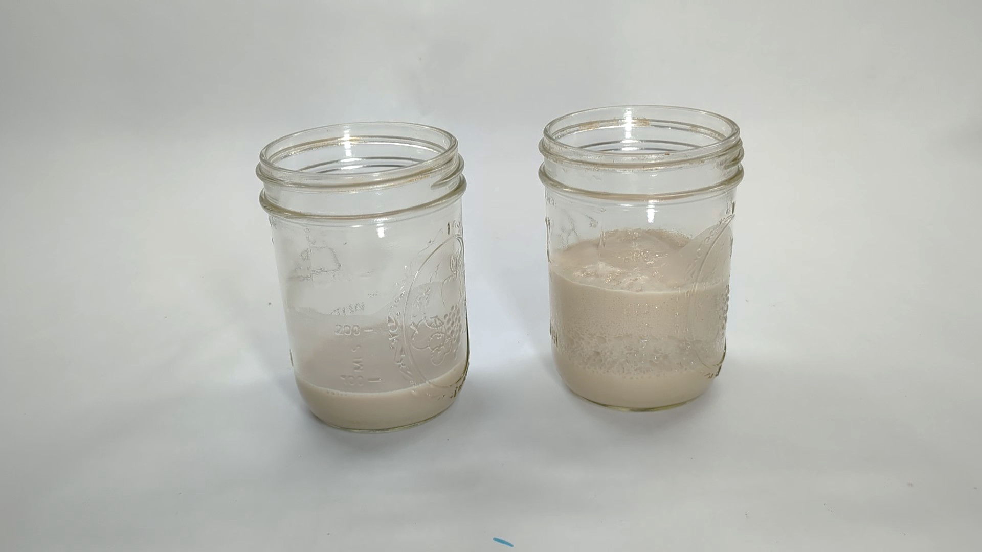
A
B
Notes:
www.sciencebuddies.org
Figure 2. Expected results for yeast with and without sugar. (A) Yeast without sugar. (B) Yeast with sugar after 10 minutes.
Image Credit: Laura Ohl, PhD / ScienceBuddies

Slide 5
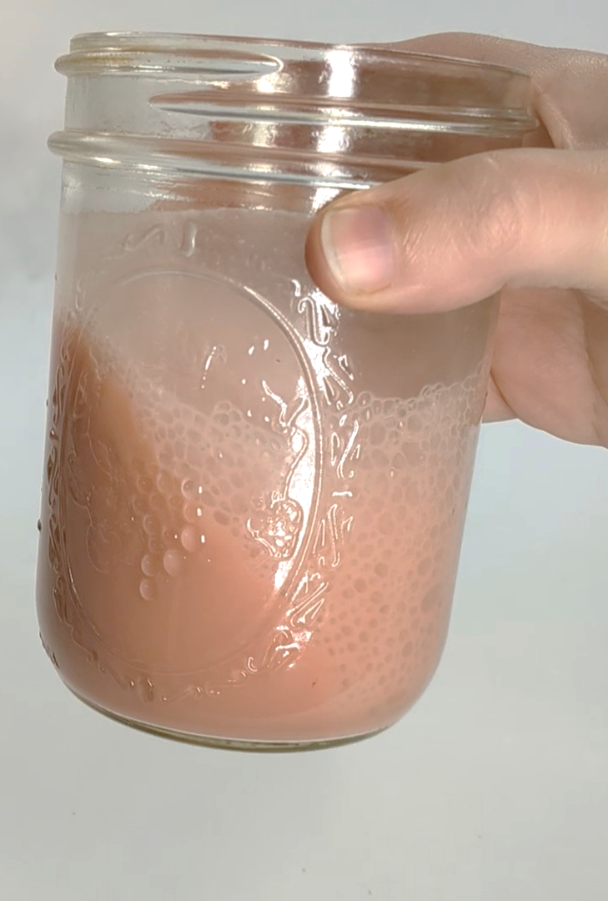
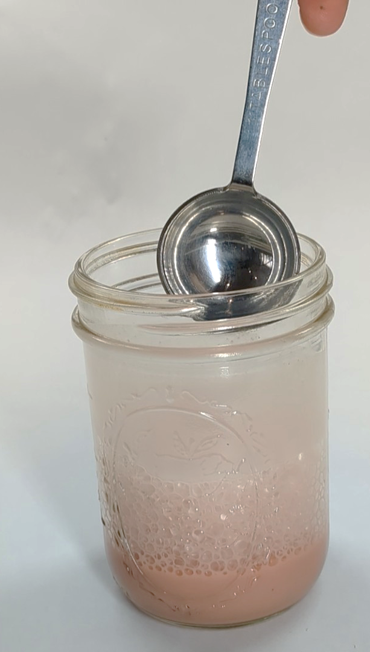
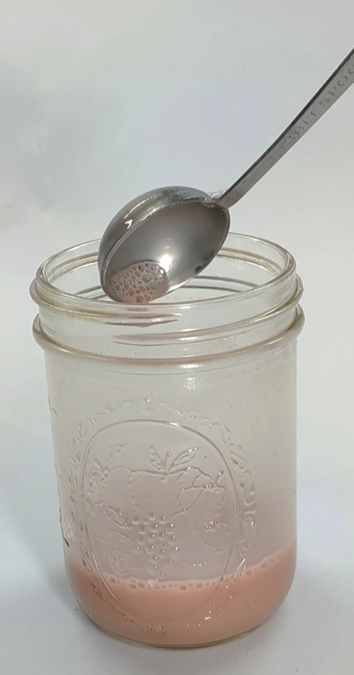
A
B
C
Notes:
www.sciencebuddies.org
Figure 3. Expected results for the lysis of the cells. (A) Immediately after hydrogen peroxide is added foam continues to expand (B) With mixing foam reduces at 5 minutes. (C) Foam fully dissipates with mixing by 10 minutes.
Image Credit: Laura Ohl, PhD / ScienceBuddies

Slide 6
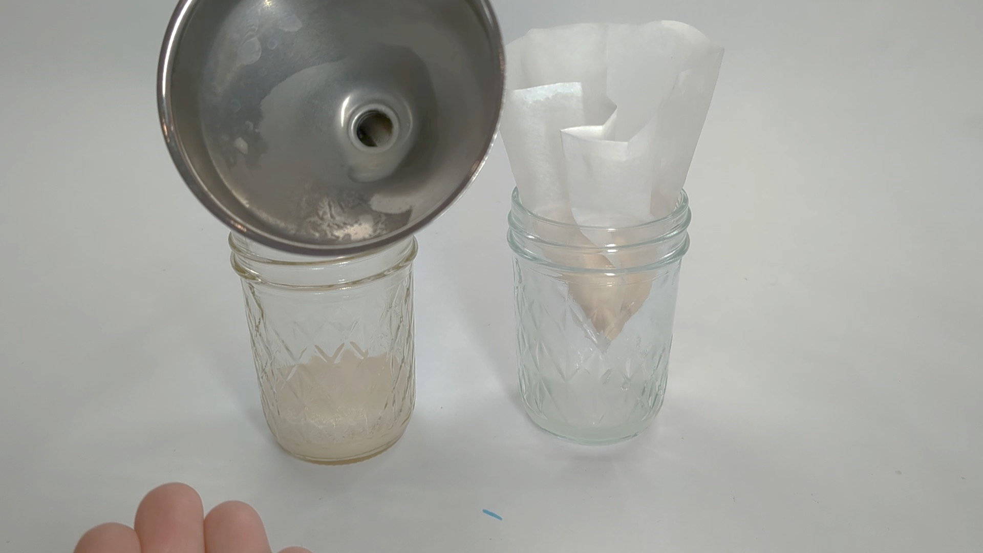
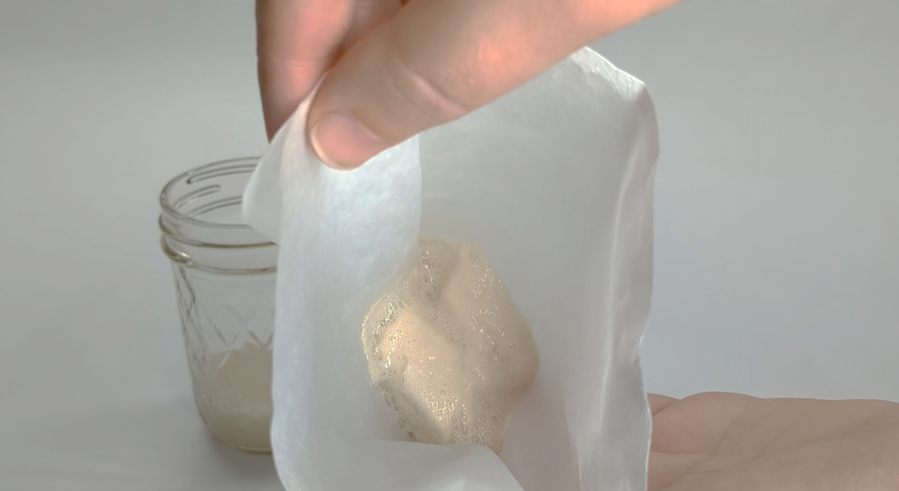
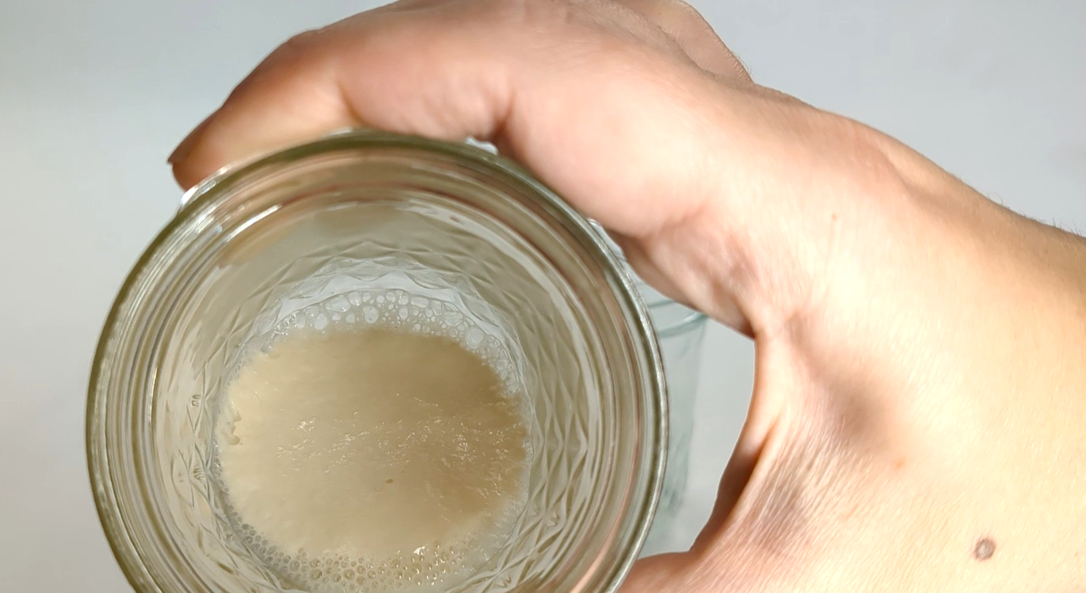
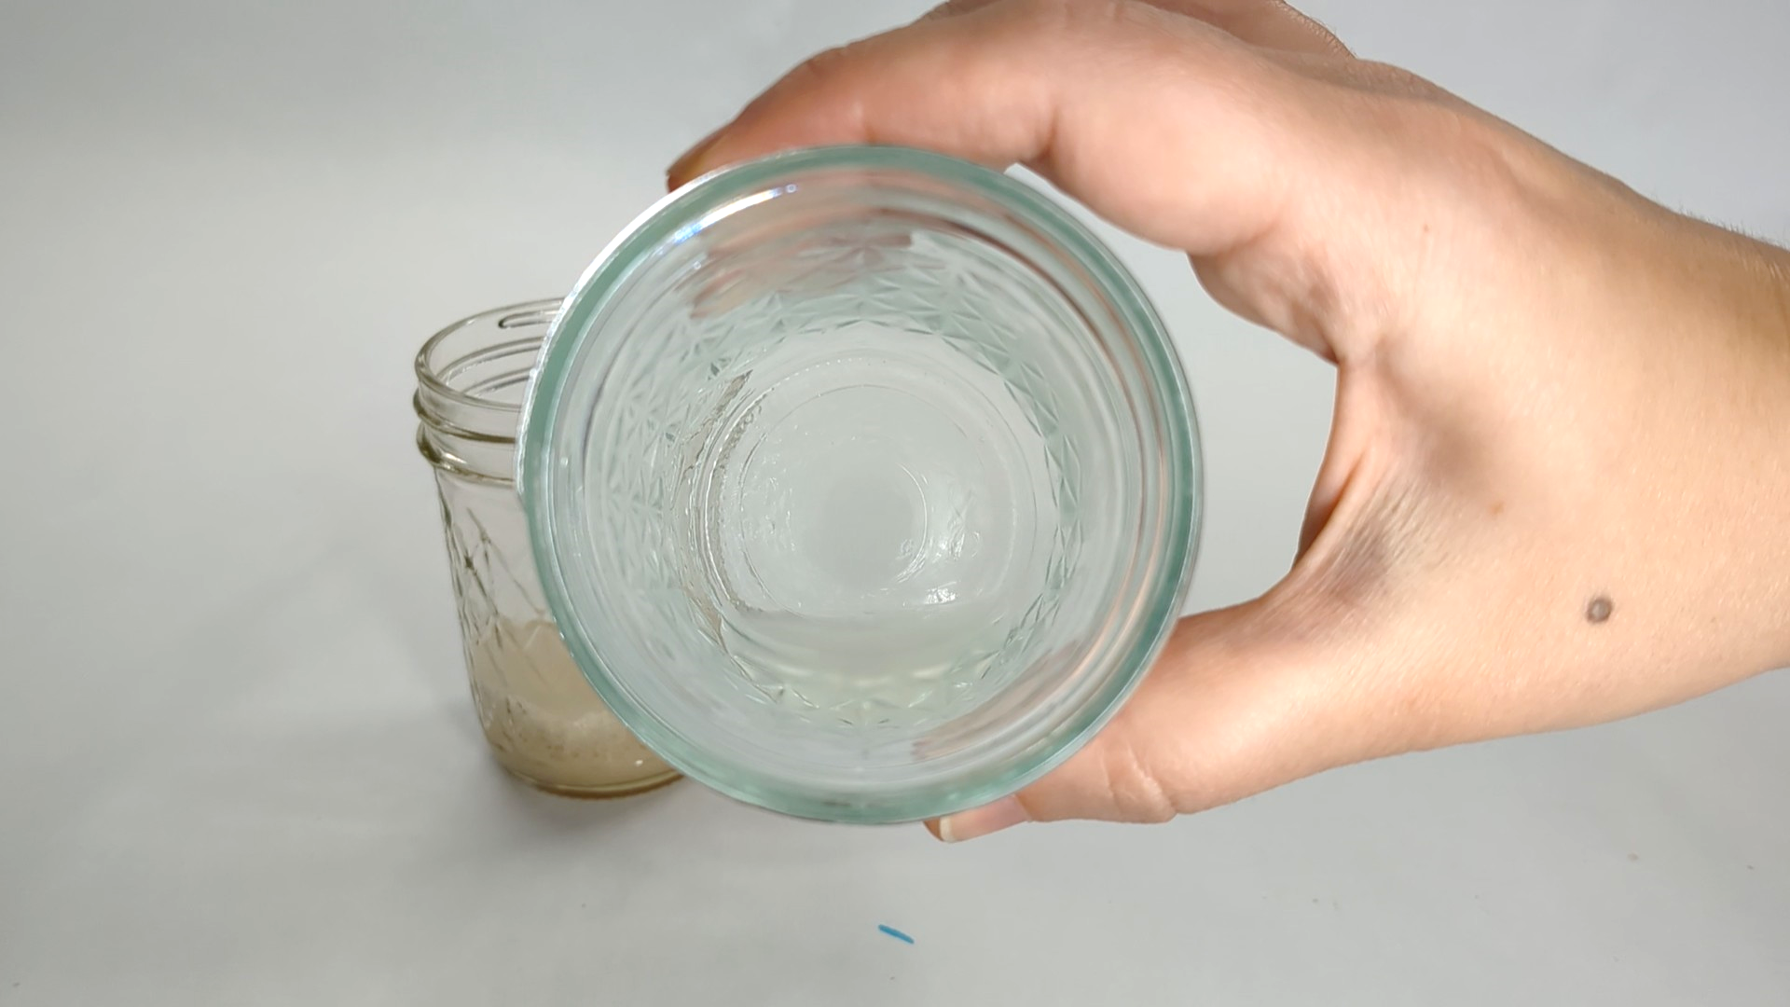
A
B
C
D
Notes:
www.sciencebuddies.org
Figure 4. Expected results for the filtration of protein from cells. (A) The funnel is clear of cell debris. (B) The filter is full of yeast cell debris (pictured here undyed). (C) The unfiltered solution remains the same as the previous solution. (D) Filtered solution results in clear “purified protein.”
Image Credit: Laura Ohl, PhD / ScienceBuddies

