Slide 1


Pulleys and the Pyramids

Slide 2
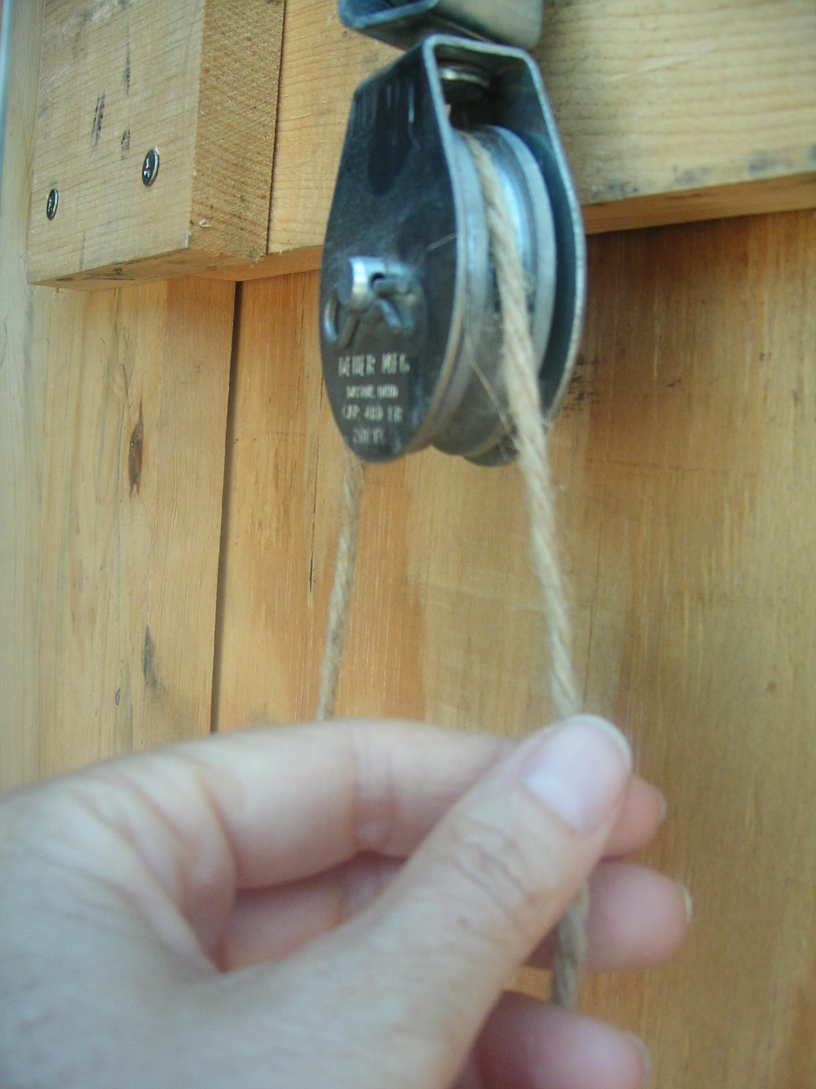
What is a pulley?
A pulley is a wheel
A pulley uses rope that goes around the wheel
The rope attaches to objects
The other end of the rope has a force applied
  Applied force is a push or a pull
Photos should be a
square like this.

Slide 3
Fixed Pulley
Pulley
Force
Rope
Fixed Pulley
Object moves
Pulley stays in the same spot
Force applied only on one end of the rope
Weight

Slide 4
Movable Pulley
Reaction Force
Force
Movable Pulley
Pulley is attached to object
Pulley and object move together
Rope is attached to something that does not move
Force applied to other end of rope
Rope
Pulley
Weight

Slide 5

Who has seen pulleys?
…Pulleys are all around us…
Photos should be a
square like this.
Elevator
Window shades and blinds
Flagpole

Slide 6

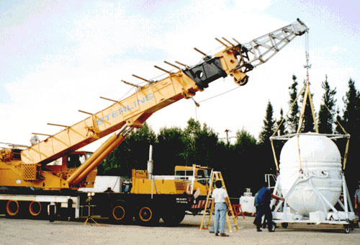
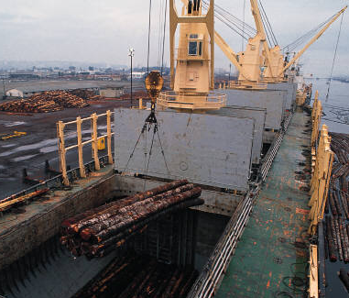
More examples
Sails and fishing nets
Cranes
Clothes lines
Gym training equipment
Rock climbing gear

Slide 7
Why use pulleys?
Makes lifting things easier
Pulleys redirect force
  Enables us to use gravity to help us (is it usually easier to pull down to life something up)
Using several pulleys reduces the force required to lift an object
  We have to use more rope and make the rope go further
  Mechanical Advantage: More distance traveled, but less force required

Slide 8
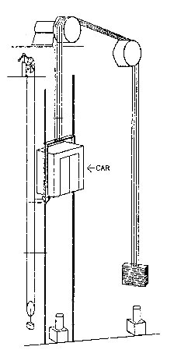
Using Gravity
Elevator Pulleys
Easier to pull down than up
Elevators use gravity
  Counterweight on the other side of the cable
  Gravity already applying force on counterweight
  Less powerful motor required
Counterweight

Slide 9

System of Pulleys
The force needed to raise this weight is ¼ the weight of the object
Weight

Slide 10
Building the
Pyramids

Slide 11
Vocabulary & Definitions
Force: A push or a pull on an object
Fixed pulley: A pulley attached to a fixed point with the rope attached to the object
Movable pulley: A pulley attached to the object itself, with one end of the rope attached to a fixed point
Redirect force: To change the direction of a push or pull to gain advantage over a task
Mechanical advantage: The advantage gained by using simple machines; trading distance for force

Slide 12
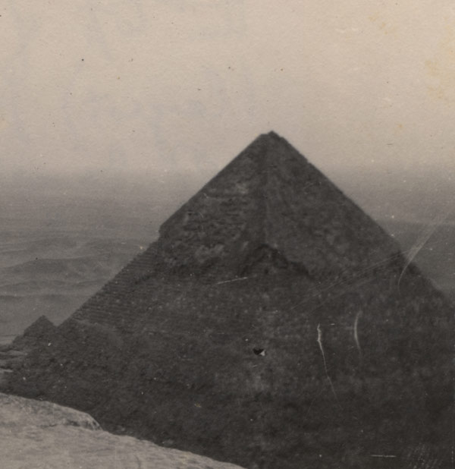
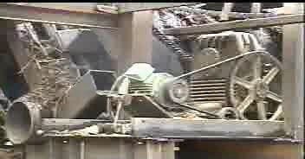
References
Drawing of block and tackle (right) is Copyright © U.S. Department of Transportation, Federal Highway Administration, Handtools for Trailwork, http://www.fhwa.dot.gov/environment/fspubs/05232810/page16.htm
Photo of Giza pyramid (right) is Copyright © National Library of Medicine, Profiles in Science, The Wilbur A. Sawyer Papers, http://profiles.nlm.nih.gov/LW/B/B/D/Y/
Photo of crane (right) is Copyright © NASA, Nightglow, Interesting Vehicles, http://nightglow.gsfc.nasa.gov/vehicles.html
Drawing of mine elevator (right) is Copyright © U.S. Department of Labor, Mine Safety and Health Administration, http://www.msha.gov/S&HINFO/TECHRPT/HOIST/PAPER4.HTM
The photo of an unguarded belt and pulley (right) is Copyright © U.S. Department of Labor, OSHA, http://www.osha.gov/SLTC/woodproducts/pulley.html.
The hand and pulley photograph (right) is Copyright © Denise Carlson, ITL Program, College of Engineering and Applied Science, University of Colorado at Boulder. Used with permission.
Pulley concept drawings are Copyright © ITL Program, College of Engineering and Applied Science, University of Colorado at Boulder.
The rest of the images are Copyright © 2004 Microsoft Corporation, One Microsoft Way, Redmond, WA 98052-6399 USA. All rights reserved.

