Slide 1


BACTERIAL ADAPTATIONS AND THEIR APPLICATION IN GENETIC ENGINEERING

Slide 2
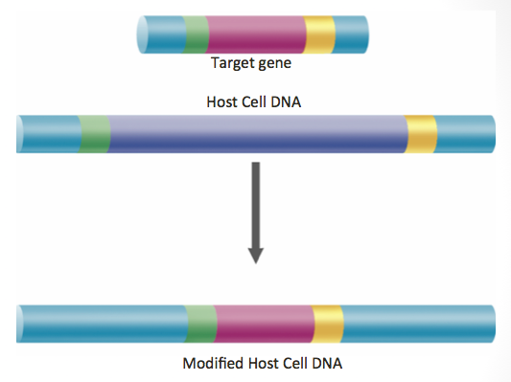
USING E. COLI FOR TRANSFORMATION
Escherichia coli has been the microorganism of choice for many experiments for various reasons:
1. It has a very fast growth rate, making it possible to grow one generation per 20 minutes
2. It is relatively easy to grow
3. It is a very useful host for creating recombinant DNA (DNA that has been formed artificially by combining DNA from two different organisms)

Slide 3

GENETIC ENGINEERING
Genetic engineering is the process through which genes are manipulated to purposefully change the genetic material and enhance organisms.
It sometimes uses bacteria because of their plasmids.
- Easy to map and modify since they are small pieces of DNA
- Cells understand how to read them and follow their instructions
Scientists can cut them open and insert a new gene from another organism then the bacteria can transfer its modified plasmid into another cell, carrying the new gene.

Slide 4
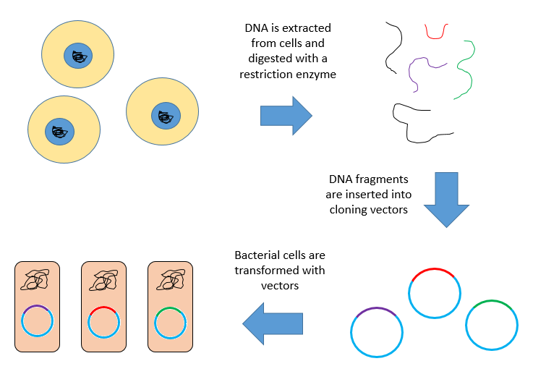
GENETIC ENGINEERING PROCESS
DNA is extracted from cells and digested with a restriction enzyme
DNA fragments are inserted into cloning vectors
Bacterial cells are transformed with vectors

Slide 5
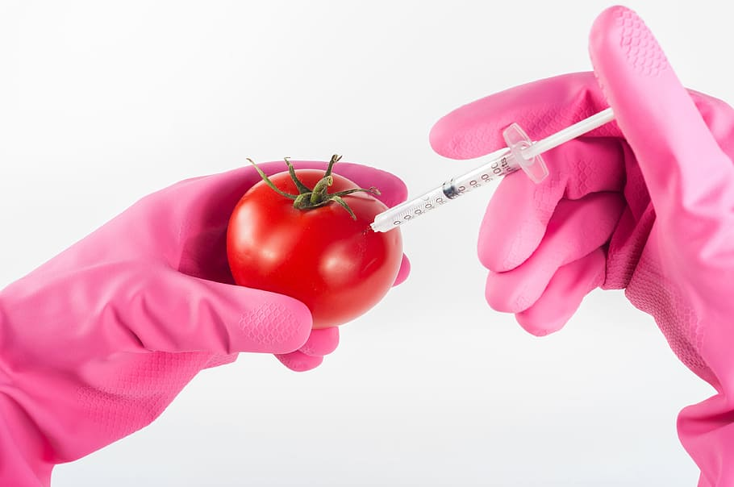
GMOs
Genetic engineering produces genetically modified organisms (GMOs) which are organisms that have had their genes changed in a way that does not happen naturally.
Watch this video about genetically modified foods
What are your thoughts on genetically modified organisms?

Slide 6



GMO EXAMPLES
Plants that have a higher nutritional value, can survive with less water, grow larger, or can tolerate exposure to herbicides.
Glow in the dark cats that help them resist feline AIDS.
Genetically engineered E. coli detect cancerous tumor in mice liver and cause their urine to change color as a warning

