Slide 1
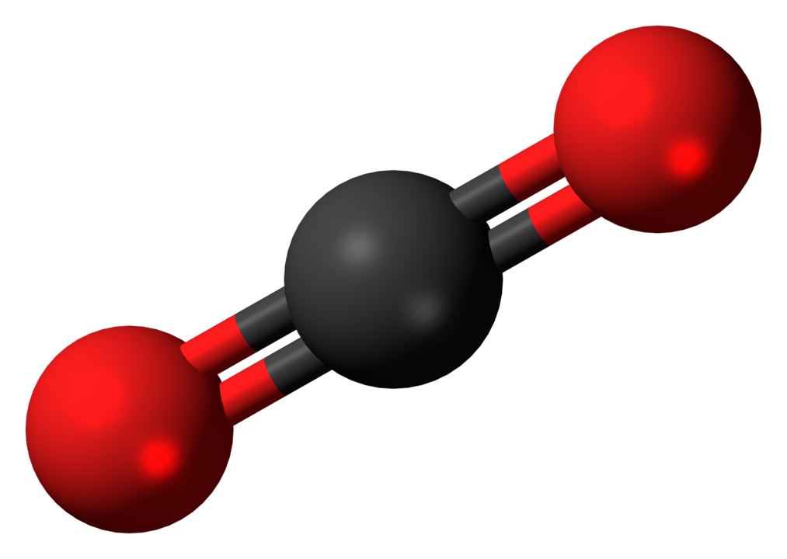
Carbon Dioxide CO2
O=C=O

Slide 2
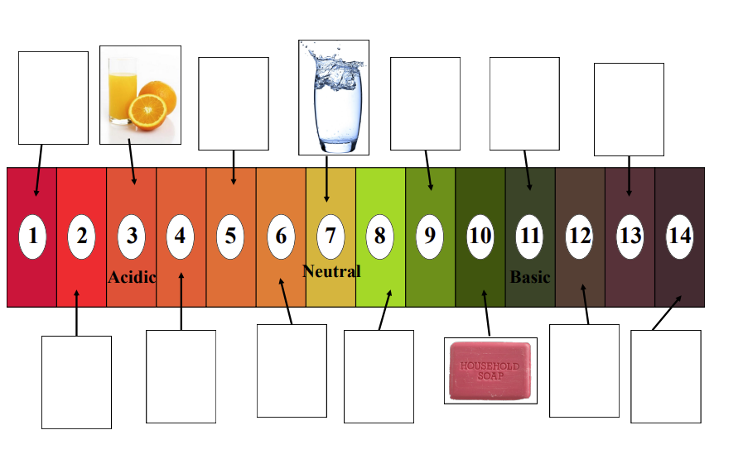
The pH Scale

Slide 3

The pH Scale
What pH is stomach acid?

Slide 4
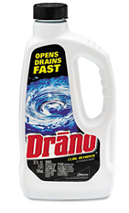
The pH Scale
What pH is drain cleaner?

Slide 5
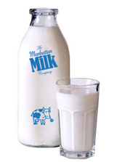
The pH Scale
What pH is milk?

Slide 6

The pH Scale
What pH is lemon juice?

Slide 7
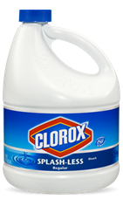
The pH Scale
What pH is bleach?

Slide 8

The pH Scale
What pH is coffee?

Slide 9
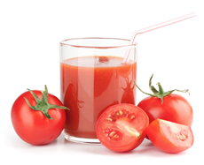
The pH Scale
What pH is tomato juice?

Slide 10
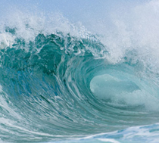
The pH Scale
What pH is ocean water?

Slide 11
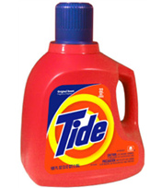
The pH Scale
What pH is liquid laundry detergent?

Slide 12
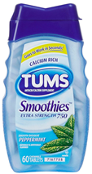
The pH Scale
What pH are antacids?

Slide 13
The pH Scale

Slide 14
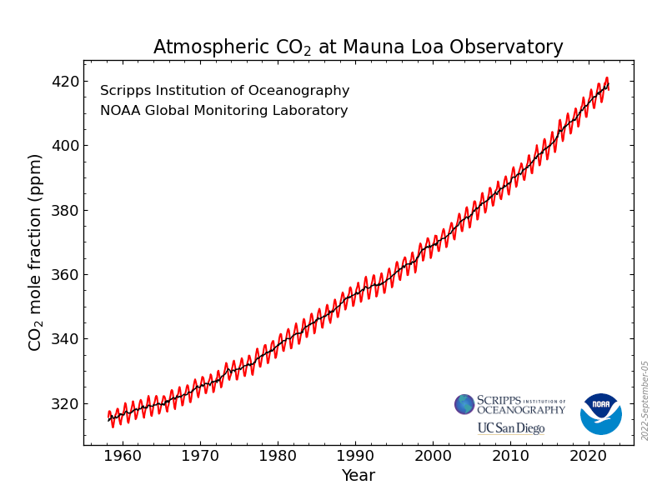
What has happened to atmospheric CO₂ over time?
Notes:
Source: NOAA Earth System Research Laboratories, Global Monitoring Laboratory retrieved September 21, 2022 from https://gml.noaa.gov/ccgg/trends/

Slide 15
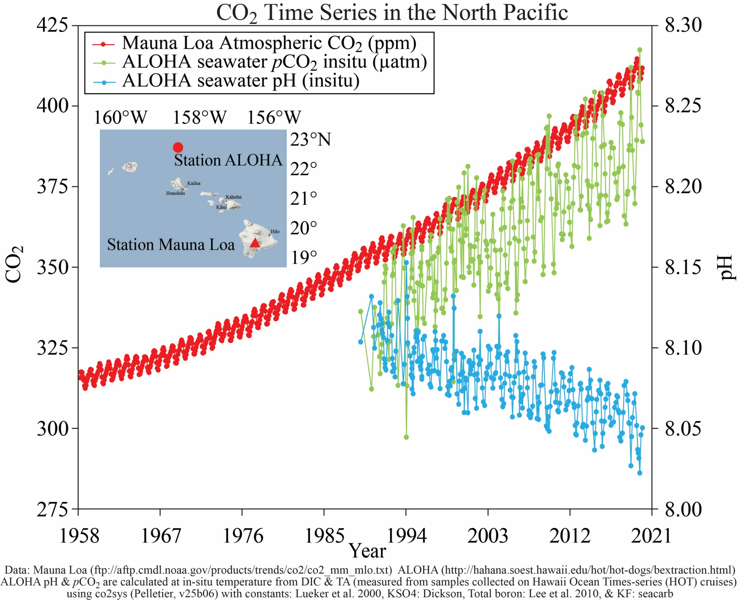
How has increased atmospheric CO₂ changed
the ocean over time?
Notes:
Source: NOAA Pacific Marine Environmental Laboratory (PMEL) Carbon Program retrieved September 21, 2022 from https://www.pmel.noaa.gov/co2/file/Hawaii+Carbon+Dioxide+Time-Series

Slide 16
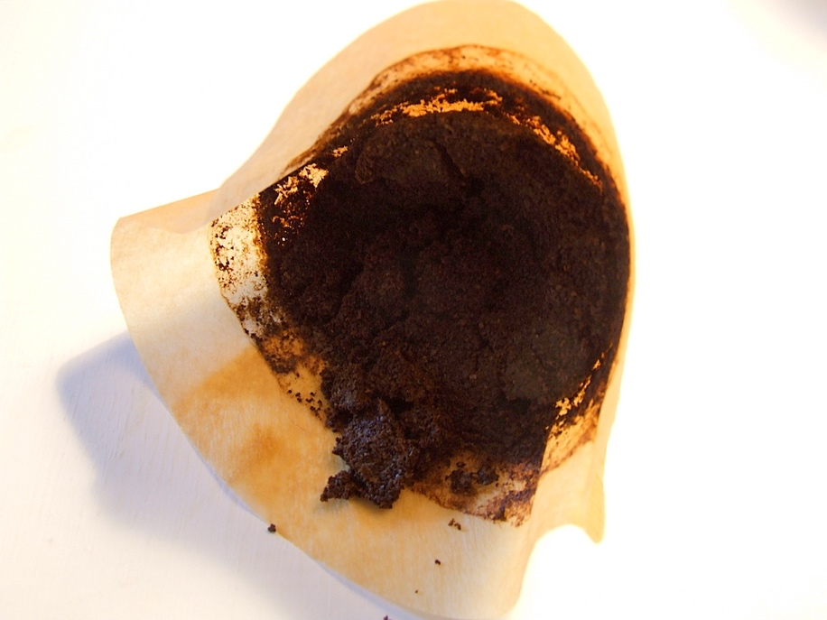
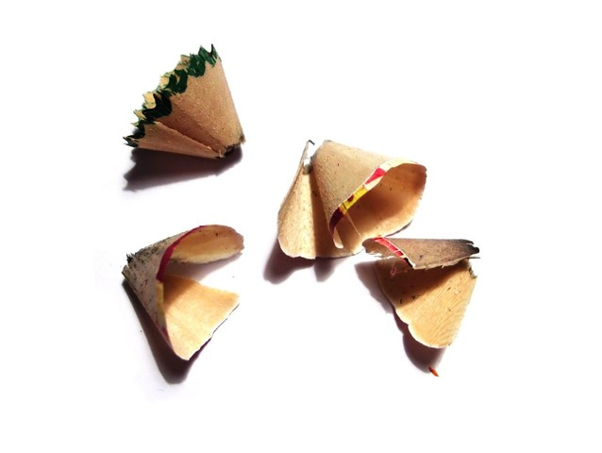
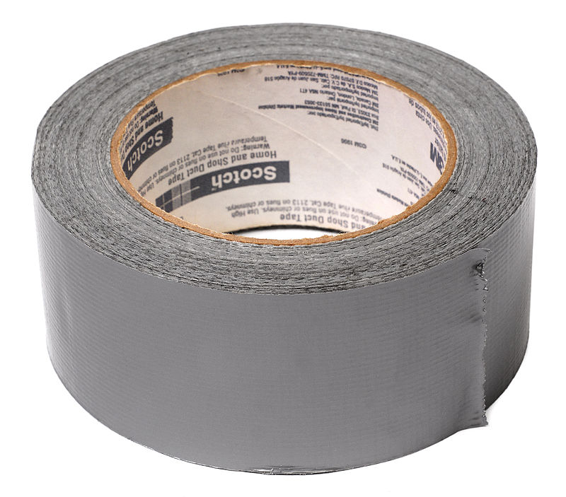

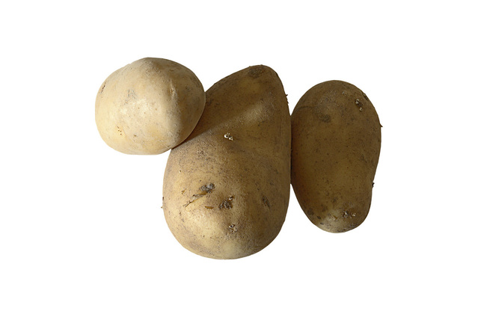
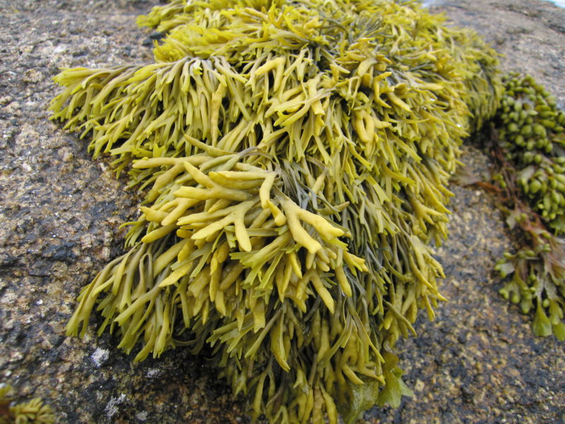
Coffee grounds
Pencil shavings
Which 2 items are being used in carbon capture technology?
Estormiz/Public Domain
Martin BOULANGER/FreeImages.com/Creative Commons
Duct tape
Paper
Dan Petru/FreeImages.com/Creative Commons
Public Domain, https://commons.wikimedia.org/w/index.php?curid=11293743
Potatoes
Seaweed
: Photo by Tom Corser www.tomcorser.com. Licensed under Creative Commons Attribution ShareAlike 2.0 England & Wales (UK) Licence: http://creativecommons.org/licenses/by-sa/2.0/uk/deed.en_GB
Antonio Jimenez Alonso/FreeImages.com/Creative Commons

